Slide 1
Proposal 3
The Basics
Camilla, Alex, Cameron

Slide 2
This Week’s Goals – Finalizing our first level
Background – Started, but Relies on Level Design
HUD – Health Bar, Weapon Inventory (?), Something to keep track of our powerups – Not Started
Troubleshoot our Ghost Enemy – They’re not doing so well... – Not Done
Sort out our Level Design – Still Discussing
Figure out level dimensions
Parkour Additions
Make things a level instead of an enemy test!
Begin working on Weapons, Bullets, etc. - Discussing
SFX - Done
Potentially figuring out weapon drop percentages

Slide 3
Why Do These Changes Matter
They complete our first main goal! We hope to have at least have our level design and background finished by next demo
They finally add playability and hopefully a win/lose condition
We can finally work on making this game rouge-like platformer.

Slide 4
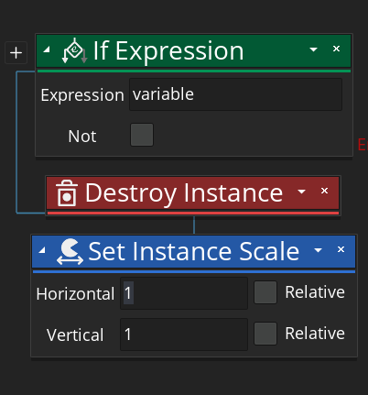
Icons
If Expression takes a variable and returns a Boolean based on the state of Boolean.
Destroy Instance completely removes an instance of an object
Set Instance Scale is used to scale sprites. We use it to change our sprites on a horizontal basis to flip the sprite.

